Slide 1
Skin Disease Detection using Hybrid CNNs
BCSE403L - Digital Image Processing
Submitted To: Dr Geetha S​
Saimirra R - 21BCE1656 ​​
Harshini B V - 21BCE1336 ​​
Ulagarchana U - 21BCE1279​

Slide 2
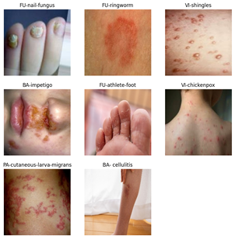
Motivation
With the increasing prevalence of skin diseases globally, an accurate and automated diagnostic system is essential to improve early detection and patient outcomes. This project aims to enhance diagnostic accuracy through a hybrid CNN model that combines the strengths of DenseNet and InceptionV3 for robust feature extraction. By focusing on computational efficiency and scalability, the proposed solution is designed to be deployable across diverse clinical settings, making it a valuable tool for both advanced medical centers and resource-limited healthcare facilities.

Slide 3
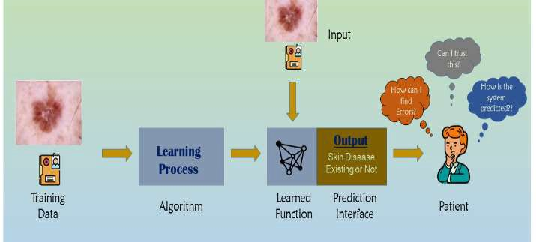
Introduction
Skin diseases are a significant global health concern, with early detection playing a crucial role in effective treatment and improved patient outcomes. Traditional diagnostic methods are often time-consuming and require specialized dermatological expertise, creating a demand for automated and accurate solutions.
In recent years, deep learning models, particularly CNNs, have demonstrated exceptional performance in medical image analysis. This project focuses on developing a hybrid CNN model that combines the strengths of DenseNet and InceptionV3 to enhance diagnostic precision, reduce complexity, and offer a scalable solution suitable for diverse clinical settings.

Slide 4
Abstract
This project introduces a novel approach for skin disease detection using a hybrid deep learning model that achieves improved diagnostic accuracy and efficiency. The hybrid model integrates the strengths of two high-performing Convolutional Neural Network (CNN) architectures, DenseNet121 and InceptionV3, which individually attained accuracies of 93.13% and 93.13%, respectively. By combining these models, the hybrid approach achieved an enhanced overall accuracy of 94.85%. This strategy optimizes feature extraction and lesion classification, addressing the limitations of single-model CNNs while maintaining computational efficiency through layers such as Pooling 2D and SoftMax. Additional models, VGG16 and MobileNetV2, were also evaluated with accuracies of 85.41% and 88.41%, respectively, underscoring the effectiveness of the selected architectures for ensemble learning. Although Generative Adversarial Networks (GANs) were proposed for future implementation to augment training data diversity with synthetic lesion masks, this study demonstrates the feasibility of a hybrid CNN model as a scalable and adaptable solution for real-time skin disease detection, bridging artificial intelligence research with practical healthcare applications.
Keywords - Skin disease detection, Convolutional Neural Network, feature extraction, Generative Adversarial Networks, diagnostic accuracy, real-time applications.

Slide 5
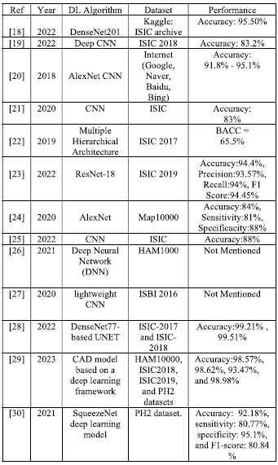
Study of Existing Work
CNN in Medical Imaging: Many existing works utilize CNNs for medical diagnostics, achieving high accuracy but often limited by overfitting on small datasets or high computational costs.
Limitations of Existing Systems: Most systems lack a hybrid approach, leading to gaps in sensitivity and specificity crucial for clinical application.
Base Paper: https://ieeexplore.ieee.org/document/10107401/

Slide 6
Objectives
Evaluate
Multiple CNN models for skin lesion detection accuracy.
Combine
Top-performing CNNs into a hybrid model for enhanced feature extraction.
Maximize
Diagnostic precision with a hybrid approach to lesion classification.
Utilize
Pooling 2D layers to reduce model complexity and improve efficiency.
Apply
Softmax activation for clear, probabilistic lesion predictions.

Slide 7
Objectives
Implement techniques like dropout and batch normalization to prevent overfitting and enhance model generalization.
Develop a hybrid CNN model combining DenseNet and InceptionV3 for improved diagnostic accuracy and feature extraction.
Ensure computational efficiency to create a scalable model suitable for deployment in clinical and remote healthcare settings.
Enhance model robustness and adaptability for diverse clinical cases by leveraging advanced preprocessing and data augmentation techniques.
Provide a reliable and automated solution for classifying multiple skin disease types with high sensitivity and specificity.

Slide 8
Proposed Methodology
Model Selection: Test and evaluate various CNN architectures, such as ResNet and Inception, based on performance metrics.
01
Hybrid Model Formation: Combine two top-performing CNN models into a single pipeline to maximize feature extraction while minimizing classification errors.
02
Model Efficiency: Employ layers like Pooling 2D, Softmax, and activation functions to maintain a balance between accuracy and computational efficiency.
03

Slide 9
Novelty in the Proposed Methodology
Enhanced Generalization: Achieved through comprehensive data augmentation techniques, ensuring robust model performance across diverse skin disease types.
Feature Fusion: Combines features extracted from DenseNet and InceptionV3 to leverage the unique strengths of both architectures, enhancing diagnostic accuracy.
Pixel-wise Classification: Enables precise categorization of skin diseases by capturing fine-grained details from input images.
Reduced Complexity: Utilizes techniques like Pooling 2D and efficient dense layers to balance high accuracy with low computational demand, making the model suitable for real-time applications.

Slide 10
Modules Used
TensorFlow and Keras: Core framework and high-level API for building and training the hybrid CNN model.
PyTorch: Alternative deep learning library, useful for GAN development and experimentation.
OpenCV: Image processing library for preprocessing and augmenting skin lesion images.
Seaborn & Matplotlib: Visualization libraries for plotting model performance metrics.
NumPy & Pandas: Data manipulation and array handling for efficient data loading.
scikit-learn: Provides tools for model evaluation, including accuracy and loss calculations.

Slide 11
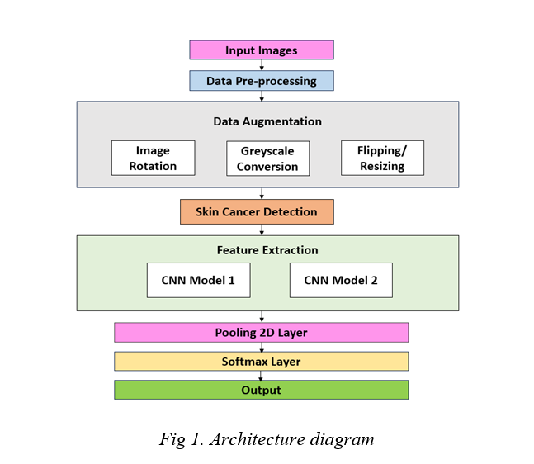
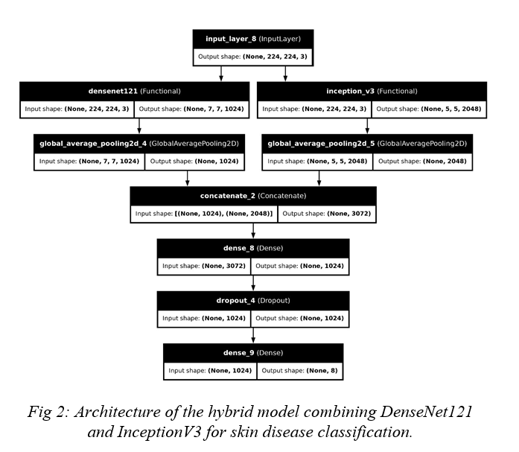
Architecture Diagram

Slide 12
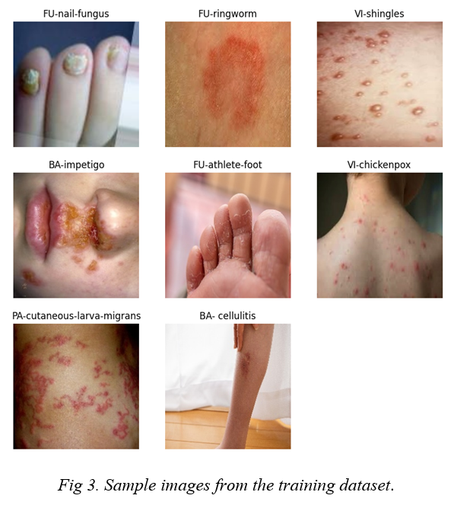
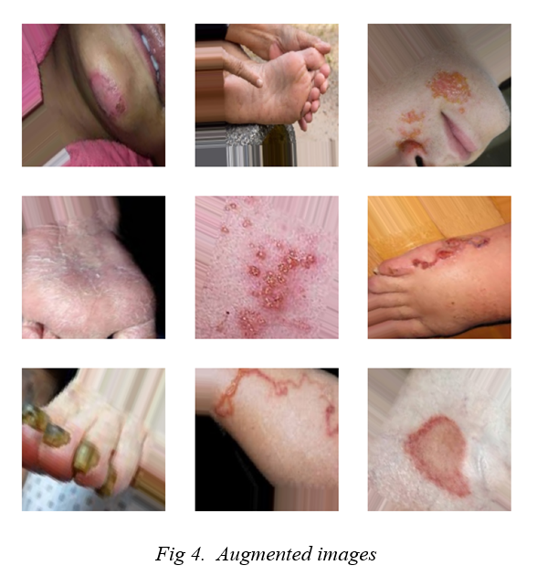
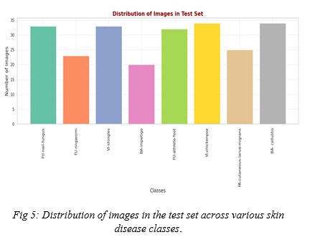
Results and Discussions

Slide 13
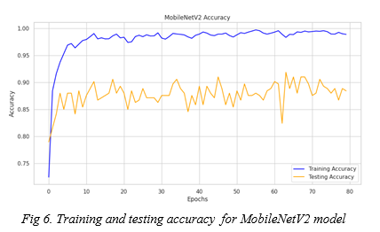
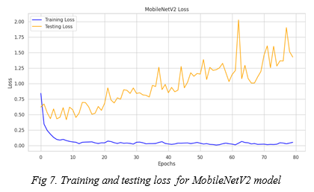
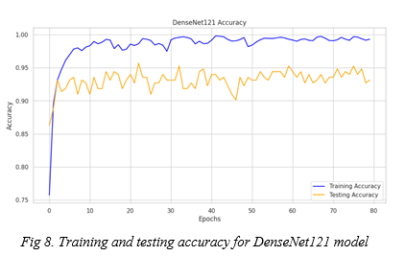
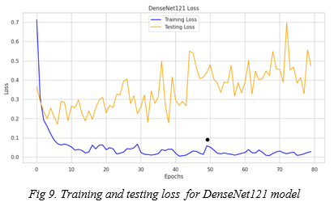
Results and Discussions

Slide 14
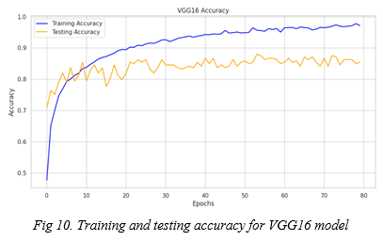
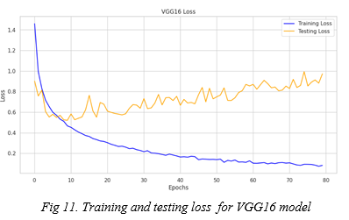
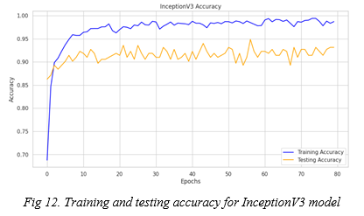
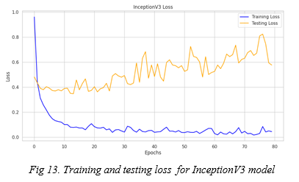
Results and Discussions

Slide 15
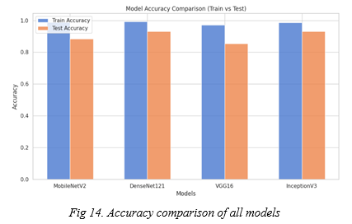
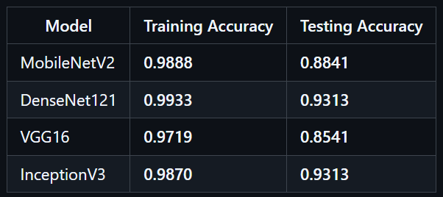
Results and Discussions

Slide 16
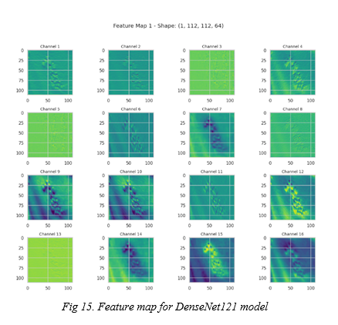
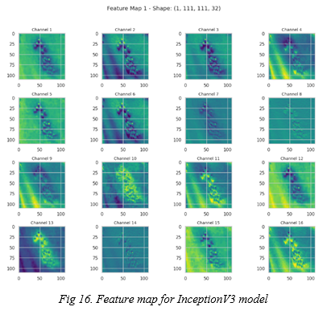
Results and Discussions

Slide 17
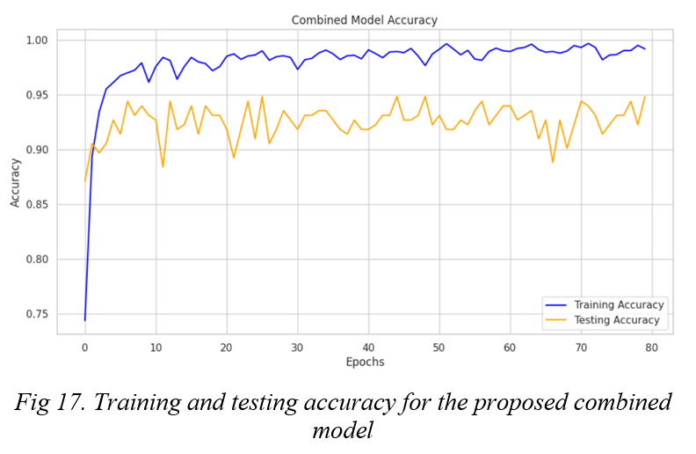
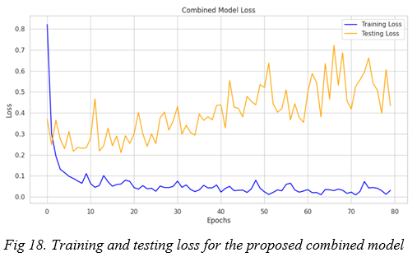

Results and Discussions

Slide 18
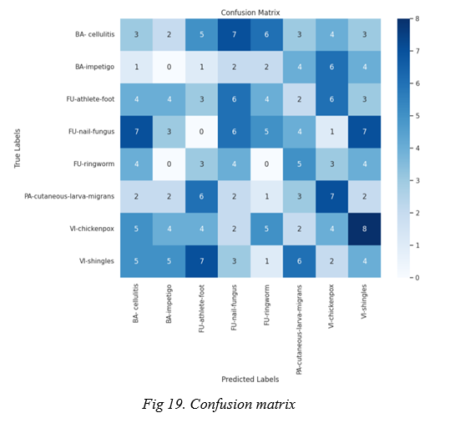
Results and Discussions

Slide 19

Future Enhancements
Expanded Dataset with GAN-Augmented Data: Use GAN-generated masks to supplement training data, improving model performance across diverse skin types and conditions.
Real-Time Diagnostic Application: Adapt the hybrid CNN model for mobile or embedded applications for rapid diagnosis in clinical and remote settings.
Explainable AI (XAI) Integration: Add interpretability features to explain the model’s predictions, improving clinician trust and aiding in decision-making.

Slide 20
References
[1] W. Gouda, N. U. Sama, G. Al-Waakid, M. Humayun, and N. Z. Jhanjhi, ‘‘Detection of skin cancer based on skin lesion images using deep learning,’’ Healthcare, vol. 10, no. 7, p. 1183, Jun. 2022.
[2] U.-O. Dorj, K.-K. Lee, J.-Y. Choi, and M. Lee, ‘‘The skin cancer classification using deep convolutional neural network,’’ Multimedia Tools Appl., vol. 77, no. 8, pp. 9909–9924, Apr. 2018.
[3] R. S. Kumar, A. Singh, S. Srinath, N. K. Thomas, and V. Arasu, ‘‘Skin cancer detection using deep learning,’’ in Proc. Int. Conf. Electron. Renew. Syst. (ICEARS), Mar. 2022, pp. 1724–1730.
[4] K. Mittal, K. S. Gill, M. Kumar and R. Rawat, "Innovations in Skin Diagnostic Technologies: Utilizing a DenseNet201 Deep Learning Model for the Early Detection of Skin Cancer," 2024 IEEE International Conference on Information Technology, Electronics and Intelligent Communication Systems (ICITEICS), Bangalore, India, 2024, pp. 1-4, doi: 10.1109/ICITEICS61368.2024.10625389.
[5] S. Remya, T. Anjali and V. Sugumaran, "A Novel Transfer Learning Framework for Multimodal Skin Lesion Analysis," in IEEE Access, vol. 12, pp. 50738-50754, 2024, doi: 10.1109/ACCESS.2024.3385340.

Slide 21
References
[6] M. Nawaz, T. Nazir, M. Masood, F. Ali, M. A. Khan, U. Tariq, N. Sahar, and R. Damaševičius, ‘‘Melanoma segmentation: A frame work of improved DenseNet77 and UNET convolutional neural net work,’’ Int. J. Imag. Syst. Technol., vol. 32, no. 6, pp. 2137–2153, Nov. 2022.
[7] S. Chatterjee, J. -M. Gil and Y. -C. Byun, "Early Detection of Multiclass Skin Lesions Using Transfer Learning-Based IncepX-Ensemble Model," in IEEE Access, vol. 12, pp. 113677-113693, 2024, doi: 10.1109/ACCESS.2024.3432904.
[8] Y. N. Fu’adah, N. C. Pratiwi, M. A. Pramudito, and N. Ibrahim, ‘‘Convolutional neural network (CNN) for automatic skin cancer classification system,’’ IOP Conf. Ser., Mater. Sci. Eng., vol. 982, no. 1, Dec. 2020, Art. no. 012005.
[9] O. O. Abayomi-Alli, R. Damaševičius, S. Misra, R. Maskeliunas, and A. Abayomi-Alli, ‘‘Malignant skin melanoma detection using image aug mentation by oversampling in nonlinear lower-dimensional embedding manifold,’’ TURKISH J. Electr. Eng. Comput. Sci., vol. 29, no. SI-1, pp. 2600–2614, Oct. 2021.
[10] L. Wei, K. Ding, and H. Hu, ‘‘Automatic skin cancer detection in der moscopy images based on ensemble lightweight deep learning network,’’ IEEE Access, vol. 8, pp. 99633–99647, 2020.

